Slide 1
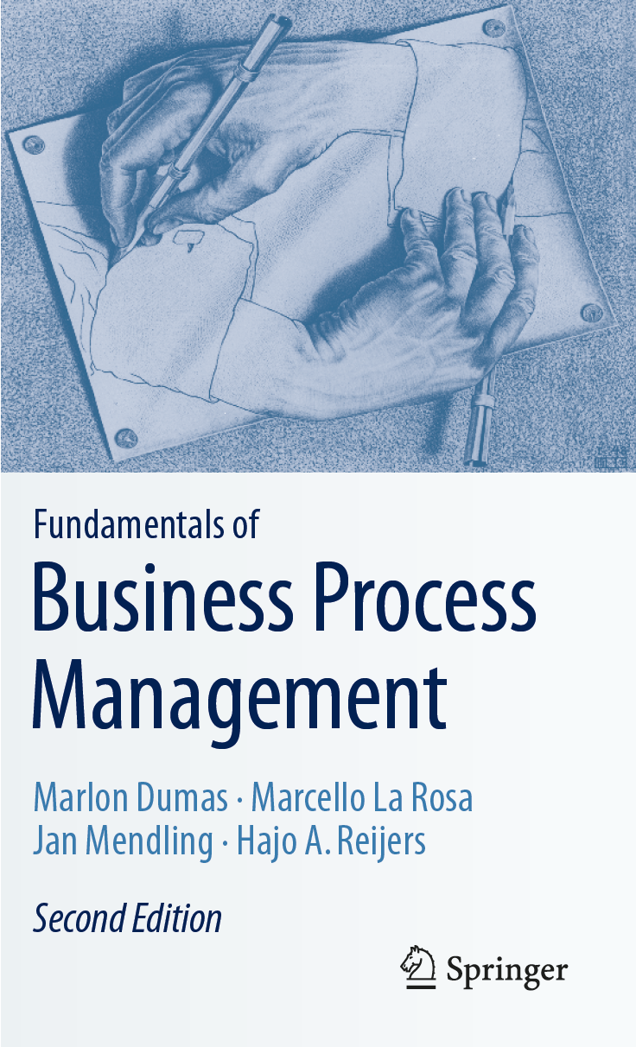
Chapter 6: Qualitative Process Analysis
Contents
Value-Added Analysis
Waste Analysis
Stakeholder Analysis & Issue Documentation
Root-Cause Analysis
Recap

Slide 2

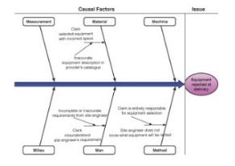
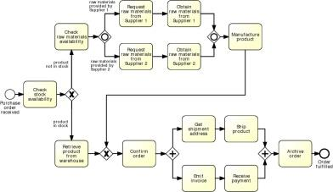

Process Analysis in the BPM Lifecycle

Slide 3
Qualitative Process Analysis: Overview
Issue Register & Pareto Chart
Value-Added & Waste Analysis
Root-Cause Analysis
Stakeholder analysis

Slide 4
Chapter 6: Qualitative Process Analysis
Contents
Value-Added Analysis
Waste Analysis
Stakeholder Analysis & Issue Documentation
Root-Cause Analysis
Recap

Slide 5
Value-added analysis
Decorticate the process into steps
Steps performed before a task
The task itself, possibly decomposed into smaller steps
Steps performed after a task, in preparation for the next task
Classify each step
Value-adding (VA)
Business value-adding (BVA)
Non-value-adding (NVA)

Slide 6
Value-adding activities
Produces value or satisfaction to the customer.
Criteria:
Is the customer willing to pay for this step?
Would the customer agree that this step is necessary to achieve their goals?
If the step is removed, would the customer perceive that the end product or service is less valuable?
Examples:
Order-to-cash process: Confirm delivery date, Deliver products
University admission process: Assess application, Notify admission outcome

Slide 7
Business value-adding activities
Necessary or useful for the business to operate.
Criteria
Is this step required in order to collect revenue, to improve or grow the business?
Would the business (potentially) suffer in the long-term if this step was removed? Does it reduce risk of business losses?
Is this step required in order to comply with regulatory requirements?
Example
Order-to-cash process: Check purchase order, Check customer’s credit worthiness, Issue invoice, Collect payment, Collect customer feedback
University admission process: Verify completeness of application, Check validity of degrees, Check validity of language test results

Slide 8
Non-value-adding activities
Everything else besides VA and BVA
Incudes:
Handovers, context switches
Waiting times, delays
Rework or defect correction
Examples
Order-to-cash: Forward PO to warehouse, Re-send confirmation, Receive rejected products
University admission: Forward applications to committee, Receive admission results from committee

Slide 9
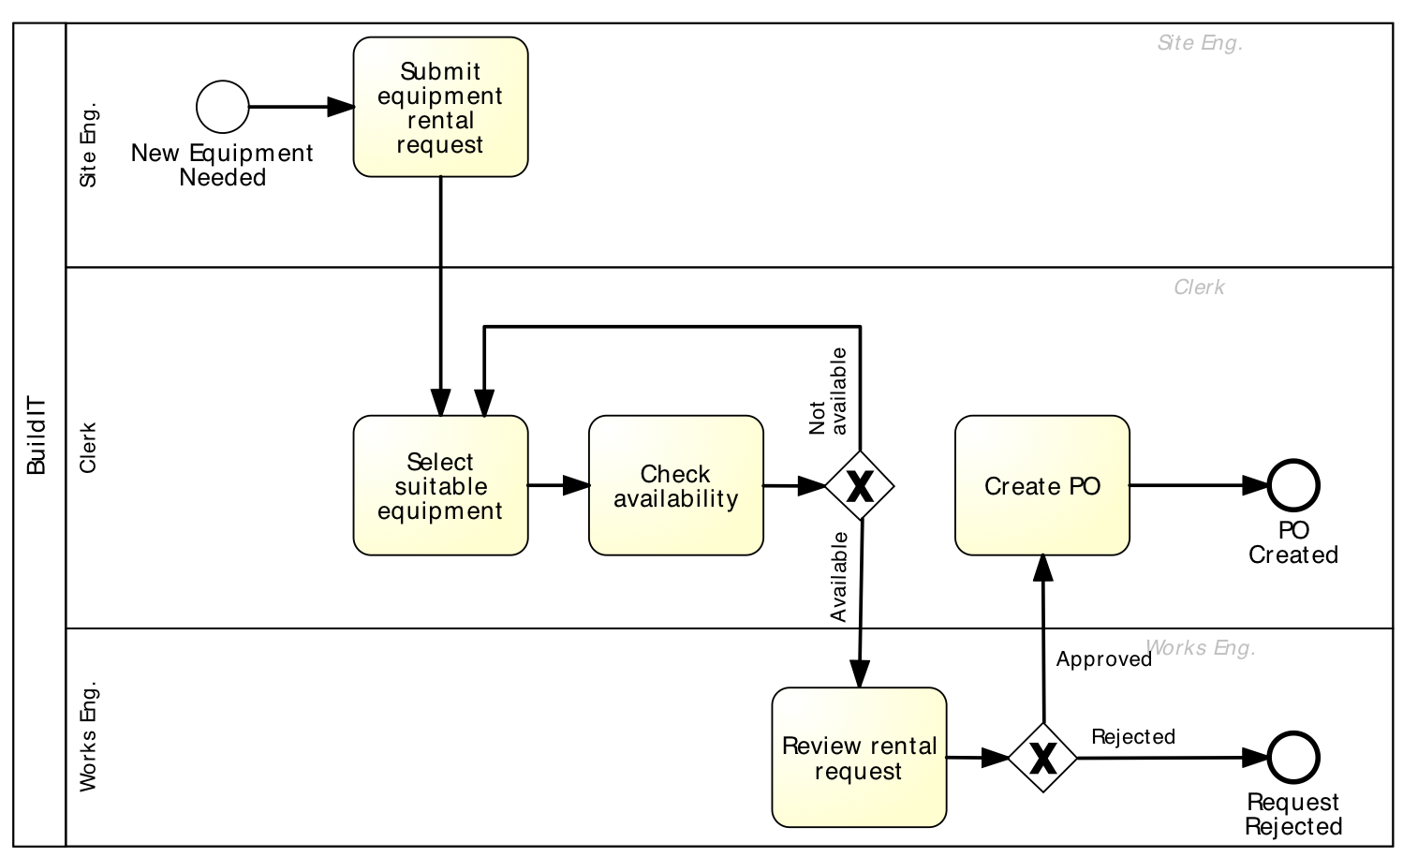
Extract of Equipment Rental Process
Fill request (VA)
Send request to clerk (NVA)
Check equipment availability (VA) – 1st time
Record recommended equipment (BVA)
Forward request to works engineer (NVA)
Open and read request (NVA)
Select suitable equipment (VA) – 1st time
Produce PO (BVA)
Submit PO to supplier (VA)
Open and examine request (BVA)
Communicate issues (BVA)
Forward request back to clerk (NVA)

Slide 10
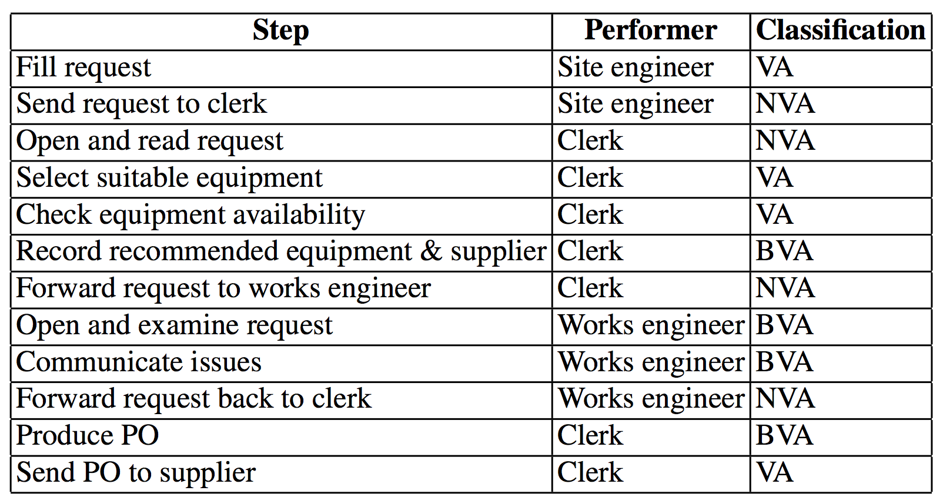
Equipment Rental Process – VA Analysis

Slide 11
Exercise
Pharmacy prescription process (Exercise 1.6)
Identify at least three VA steps, at least three BVA steps and at least three NVA steps

Slide 12
Chapter 6: Qualitative Process Analysis
Contents
Value-Added Analysis
Waste
Move
Hold
Overdo
Stakeholder Analysis & Issue Documentation
Recap

Slide 13
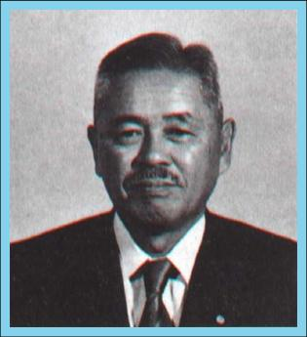
Waste analysis
"All we are doing is looking at the time line, from the moment the customer gives us an order to the point when we collect the cash.
And we are reducing the time line by reducing the non-value-adding wastes ”
Taiichi Ohno

Slide 14
Seven sources of waste
Move
Motion
Hold
Waiting (and idleness)
Over-do
Over-Processing
Over-Production
Unnecessary Transportation
Inventory
Defects

Slide 15
Move

Slide 16
Unnecessary transportation
Send or receive materials or documents (incl. electronic) taken as input or output by the process
Example:
To apply for admission at a University, students fill in an online form. When a student submits the online form, a PDF document is generated. The student is requested to download it, sign it, and send it by post together with the required documents: 1. Certified copies of degree and academic transcripts. 2. Results of language test. 3. CV. When the documents arrive to the admissions office, an officer checks their completeness. If a document is missing, an e-mail is sent to the student. The student has to send the missing documents by e-mail or post depending on document type.

Slide 17
Motion
Motion of resources internally within the process
Common in manufacturing processes, less common in business processes
Examples
Vehicle inspection process, a process worker moves with the inspection forms from one inspection base to another; in some cases inspection equipment also needs to be moved around
Approval process, a process workers moves around the organization to collect signatures

Slide 18
Hold

Slide 19
Inventory
Materials inventory
Work-in-process (WIP)
Examples
Vehicle inspection process, when a vehicle does not pass the first inspection, it is sent back for adjustments and left in a pending status. At a given point in time, about 100 vehicles are in the “pending” status across all inspection stations
University admission process: About 3000 applications are handled concurrently

Slide 20
Waiting
Waiting for materials or input data
Task waiting for a resource
Resource waiting for work (resource idleness)
Examples
Vehicle inspection process: A technician at a base of the inspection station waiting for the next vehicle
Approval process: Request waiting for approver
University admission process: Incomplete application waiting for additional documents; batch of applications waiting for committee to meet

Slide 21
Over-do

Slide 22
Defects
Correcting or compensating for a defect
Rework loops
Examples
Vehicle inspection: A vehicle needs to come back to a station due to an omission
Travel approval: Request sent back to requestor for revision
University admission: Application sent back to applicant for modification; request needs to be re-assessed later due to incomplete information

Slide 23
Over-processing
Tasks performed unnecessarily given the outcome of the process
Unnecessary perfectionism
Examples
Vehicle inspection: Technicians take time to measure vehicle emissions with higher accuracy than required, only to find that the vehicle clearly does not fulfill the required emission levels
Travel approval: 10% of approvals are trivially rejected at the end of the process due to lack of budget
University admission: Officers spend time verifying the authenticity of degrees, transcripts and language test results. In 1% of cases, these verifications uncover issues. Verified applications are sent to the admissions committee. The admission committee accepts 20% of the applications it receives

Slide 24
Over-production
Unnecessary process instances are performed, producing outcomes that do not add value upon completion
Examples
Order-to-cash: In 50% of cases, issued quotes do not lead to an order
Travel approval: In 5% of cases, travel requests are approved but the travel is cancelled
University admission: About 3000 applications are submitted, but only 800 are considered eligible after assessment

Slide 25
Equipment rental process: wastes
Send request to clerk (Transp.)
Defect
Open and read request
(Handover → transportation)
Forward request to
works engineer (Transp.)
Forward request back to clerk (Transp.)

Slide 26
Equipment rental process: wastes
Transportation
Site engineer sends request to clerk
Clerk forwards to works engineer
Works engineer send back to clerk
Inventory
Equipment kept longer than needed
Waiting
Waiting for availability of works engineer to approve

Slide 27
Equipment rental process: wastes
Defect
Selected equipment not available, alternative equipment sought
Over-processing
Rental requests being approved and then canceled by site engineer
Over-production
Equipment being rented and not used at all
Clerk finds available equipment and rental request is rejected because equipment not needed
Incorrect equipment delivered and returned to supplier

Slide 28
Exercise
Pharmacy prescription process (Exercise 1.6)
Identify wastes in this process

Slide 29
Chapter 6: Qualitative Process Analysis
Contents
Value-Added Analysis
Waste Analysis
Stakeholder Analysis & Issue Register
Stakeholder Analysis
Issue Register
Pareto & PICK Chart
Recap

Slide 30
Identifying and documenting process issues
Stakeholder analysis: allows us to collect issues from complementary perspectives.
Issue register: allows us to document issues and their impact in a structured manner
Pareto analysis and PICK charts: allow us to select a subset of issues for further analysis and redesign.

Slide 31
Stakeholder Analysis
Stajeholder analysis is about gathering data from multiple sources by interviewing stakeholders of different types and reconciling their viewpoints
In BPM, stakeholder analysis is commonly used to gather information
about issues that affect the performance of the process from different perspectives.
There are typically five categories of stakeholders:
The customer(s) of the process.
The process participants.
The external parties (e.g., suppliers, sub-contractors) involved in the process.
The process owner and the operational managers who supervise the process participants.
The sponsor of the process improvement effort and other executive managers who have a stake in the performance of the process.

Slide 32
Typical Stakeholder Concerns
Customers are often concerned about slow cycle time, defects, lack of transparency, or lack of traceability (inability to observe the current process status).
Process participants might be rather concerned about:
High resource utilization, working under stress.
Defects arising from handoffs in the process and wastes.
External parties (e.g. suppliers and sub-contractors) are generally concerned about having a steady or growing stream of work from the process, being able to plan their work ahead, and being able to meet contractual requirements.
The process owner is usually concerned with performance, be it high cycle times or high processing times. Also be concerned about common defects and wastes, and compliance with internal policy and external regulations.
The sponsor and other high-level managers are generally concerned with the strategic alignment of the process and the contribution of the process to key performance indicators. Also concerned about the ability of the process to adapt to evolving customer expectations, competition, and market conditions.

Slide 33
Issue register
Purpose: to maintain, organize and prioritize perceived weaknesses of the process (issues)
Sources of issues:
Input to a process modelling project
Collected as part of ongoing process improvement actions
Collected during process discovery (modelling)
Value-added/waste analysis

Slide 34
Issue register structure
Can take the form of a table with:
Issue identifier
Short name
Description
Assumptions
Impact: Qualitative and Quantitative
Possible improvement actions
Larger process improvement projects may require issue trackers

Slide 35
Example of an issue documentation
Issue name
Equipment kept longer than needed
Description
Site engineers keep rented equipment longer than needed by asking for deadline extensions
Assumptions
3000 pieces of equipment rented p.a.
Quantitative impact
0.1 × 3000 × 2 × 100 = 60,000 p.a
In 10% of cases, equipment is kept two days more than needed
Average rental cost is 100 per day

Slide 36
Issue Register Example
Name | Explanation | Assumptions | Qualitative Impact | Quantitative Impact
Equipment kept longer than needed | Site engineers keep equipment longer than needed via deadline extensions | 3000 pieces of equipment rented p.a. In 10% of cases, equipment kept two days longer than needed. Rental cost is 100 per day |  | 0.1 × 3000 × 2 × 100 = 60,000 p.a.
Rejected equipment | Site engineers reject delivered equipment due to non-conformance to their specifications | 3000 pieces of equipment rented p.a. 5% of them are rejected due to an internal mistake For each equipment rejected due to an internal mistake, BuildIT is billed 100. | Disrupted schedules. Employee stress and frustration | 3000 × 0.05 × 100 = 15,000 p.a.
Late payment fees | Late payment fees incurred because invoices are not paid by their due date | 3000 pieces of equipment rented p.a. Average rental time is 4 days Rental cost is 100 per day. Each rental leads to one invoice. About 10% of invoices are paid late. Penalty for late payment is 2%. | Poor reputation with suppliers | 0.1 × 3000 × 4 × 100 × 0.02 = 2400 p.a.

Slide 37
Pareto chart
Useful to prioritize a collection of issues
Bar chart where the height of the bar denotes the impact of each issue
Bars sorted by impact
Superposed curve of cumulative percentage impact

Slide 38
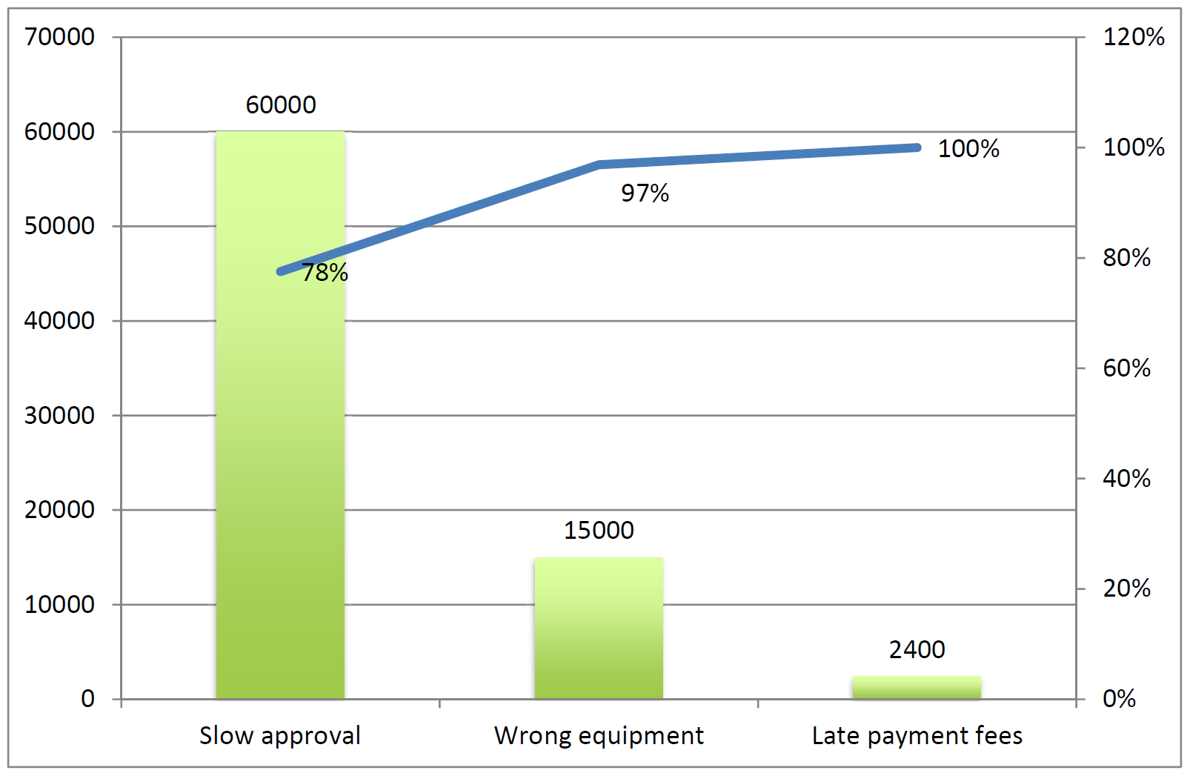
Pareto chart example

Slide 39
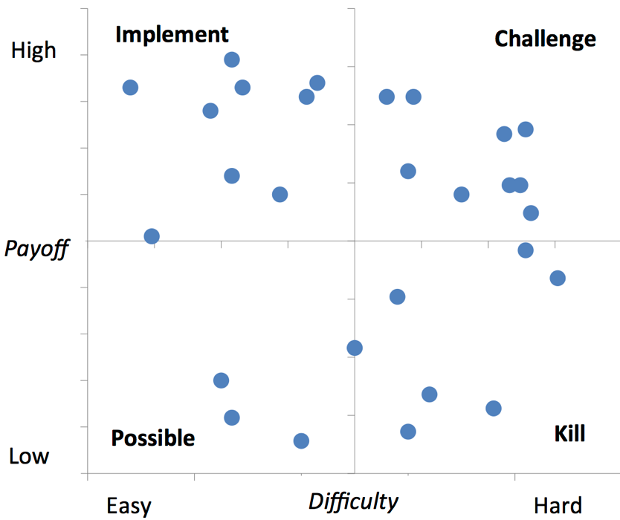
Two-Dimensional Prioritization: PICK Chart

Slide 40
Exercise
Pharmacy prescription process (Exercise 1.6)
Identify and document at least two issues in an issue register

Slide 41
Chapter 6: Qualitative Process Analysis
Contents
Value-Added Analysis
Waste Analysis
Stakeholder Analysis & Issue Register
Root-Cause Analysis
Cause-Effect Diagram
Why-Why Diagram
Recap

Slide 42
Root-cause analysis
Why-why diagram
Factors
Issue
Cause-effect diagram

Slide 43
Why-why diagram
Five levels of nesting
“Five Why’s”

Slide 44
Why-why diagram example
Site engineers keep equipment longer, why?
Site engineer fears that equipment will not be available later when needed, why?
time between request and delivery too long, why?
excessive time spent in ﬁnding suitable equipment and approving the request, why?
time spent by clerk contacting possibly multiple suppliers sequentially;
time spent waiting for works engineer to check the requests;

Slide 45
Cause-effect (Fishbone) diagram

Slide 46
Categories of causes: Six Ms
Machine: factors stemming from technology used
Lack of suitable functionality in the supporting software applications
Poor User Interface (UI) design
Lack of integration between systems
Method: factors stemming from the way the process is designed, understood or performed
Unclear assignments of responsibilities
Unclear instructions
Insufficient training
Lack of timely communication
Material: factors stemming from input materials or data
Missing, incorrect or outdated data

Slide 47
Categories of causes: Six Ms
Man: factors stemming from wrong assessments or incorrect performance of steps attributable to:
Lack of training and clear instructions
Lack of motivation
Too high demands towards process workers
Measurement: factors stemming from reliance on:
Inaccurate estimations
Miscalculations
Milieu: factors outside the scope of the process
Delays caused because of unresponsive external actors
Sudden increases of workload due to special circumstances

Slide 48
Cause-effect diagram example

Slide 49
Exercise
Pharmacy prescription process (Exercise 1.6)
Select one of the previously identified issues and analyze it using a why-why diagram

Slide 50
Chapter 6: Qualitative Process Analysis
Contents
Value-Added Analysis
Waste Analysis
Stakeholder Analysis & Issue Documentation
Root-Cause Analysis
Recap

Slide 51
Recap
Segregate value-adding, business value-adding and non-value-adding steps
Identify waste: move, hold, overdo
Collect and systematically organize issues, assess their impact, priotirize
Analyze root causes of issues

